Slide 1
Machine Learning
Data science for beginners, session 6

Slide 2
Machine Learning: your 5-7 things
Defining machine learning
The Scikit-Learn library
Machine learning algorithms
Choosing an algorithm
Measuring algorithm performance

Slide 3
Defining Machine Learning

Slide 4
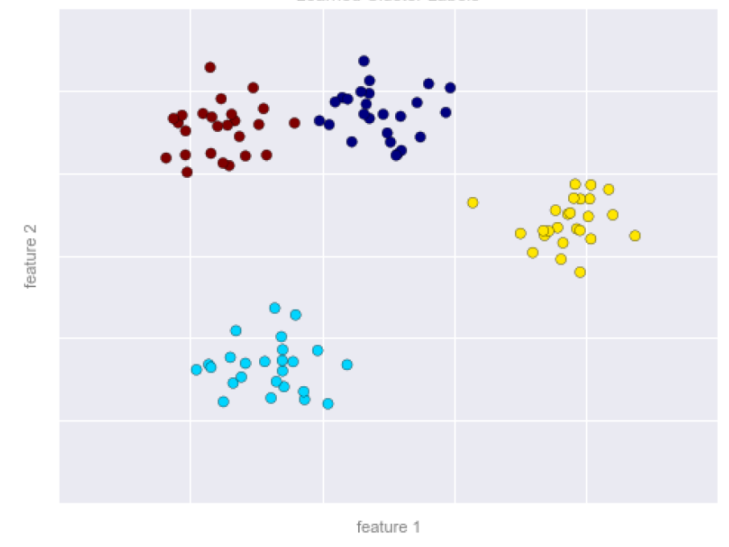
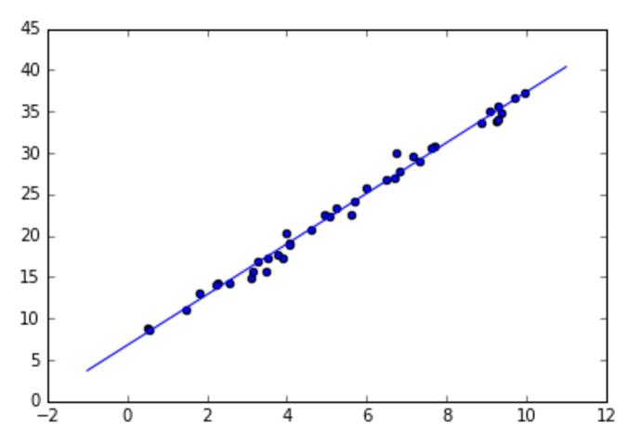
Machine Learning = learning models from data
Which advert is the user most likely to click on?
Who’s most likely to win this election?
Which wells are most likely to fail in the next 6 months?
Notes:
What you’re learning isn’t the data, but a model that will help you understand (and possibly also explain) it.

Slide 5
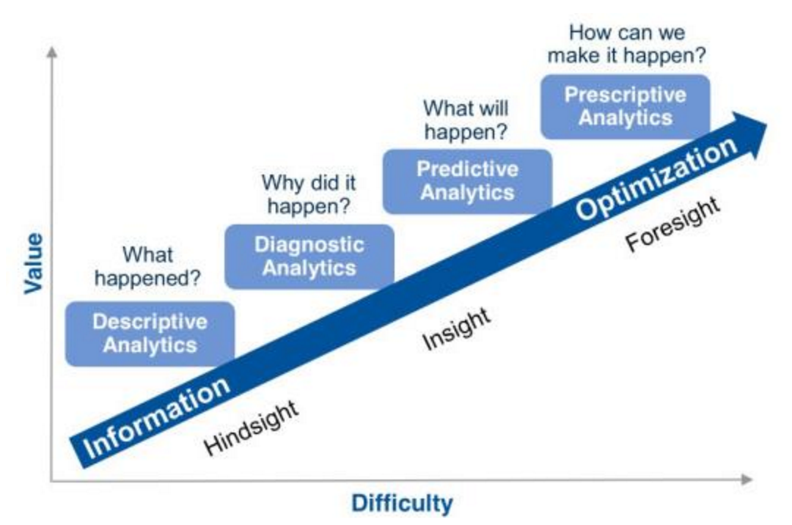
Machine Learning as Predictive Analytics...
Notes:
We bother making models because we want to start asking questions, and (hopefully) making changes in our world.
Image from http://www.rosebt.com/blog/descriptive-diagnostic-predictive-prescriptive-analytics

Slide 6
Machine Learning Process
Get data
Select a model
Select hyperparameters for that model
Fit model to data
Validate model (and change model, if necessary)
Use the model to predict values for new data
Notes:
AKA import-instantiate-fit-predict
Hyperparameter: things like “how many clusters of data do I think there are in this dataset?”

Slide 7
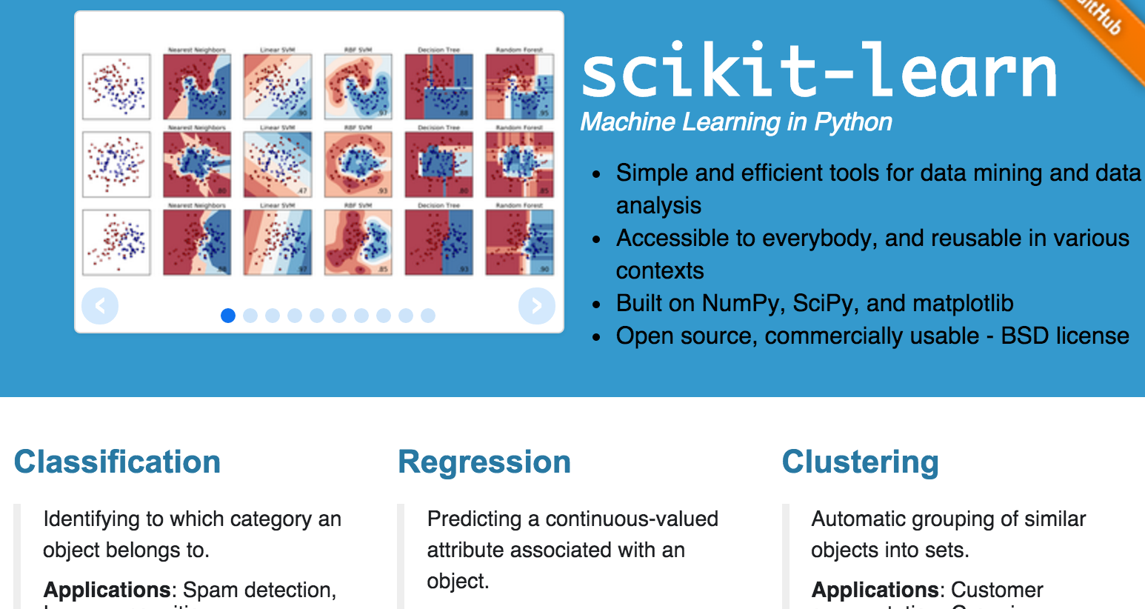
Today’s library: Scikit-Learn (sklearn)
Notes:
Lots of great tutorials on http://scikit-learn.org/stable/
You import from this library, which is called “sklearn” in python code.

Slide 8

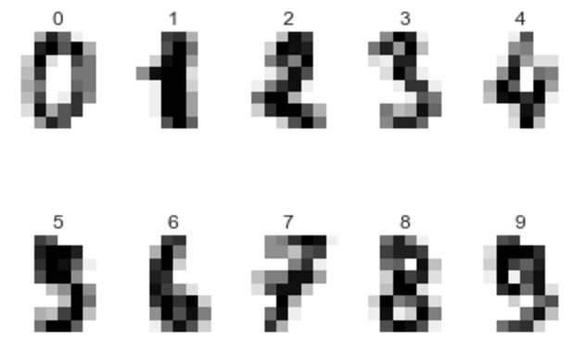
Scikit-Learn’s example datasets
Iris
Digits
Diabetes
Boston
Notes:
Iris image from Nociveglia https://www.flickr.com/photos/40385177@N07/.

Slide 9
Select a Model

Slide 10
Algorithm Types
Supervised learning
Regression: learning numbers
Classification: learning classes
Unsupervised learning
Clustering: finding groups
Dimensionality reduction: finding efficient representations
Notes:
Supervised versus unsupervised learning:
supervised = give the algorithm both input data and the answers for that data (kinda like teaching), and it learns the connection between data and answers;
unsupervised = give the algorithm just the data, and it finds the structure in that data
Semi-supervised learning (where you only have a few answers) does exist, but isn’t talked about much. There’s also reinforcement learning, where you know if a result is better or worse, but not how much it’s better or worse.

Slide 11
Linear Regression: fit a line to (numerical) data
Notes:
Fit a line to a set of datapoints. Use that line to predict new values

Slide 12
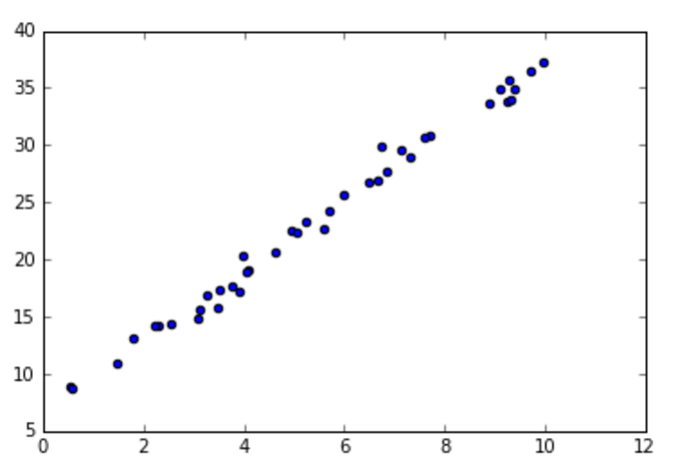
Linear Regression: First, get your data
import numpy as np
import pandas as pd
gen = np.random.RandomState(42)
num_samples = 40
x = 10 * gen.rand(num_samples)
y = 3 * x + 7+ gen.randn(num_samples)
X = pd.DataFrame(x)
%matplotlib inline
import matplotlib.pyplot as plt
plt.scatter(x,y)
Notes:
This will give you 40 random samples around the line y = 3x + 7.
Random.rand selects from a uniform distribution; random.randn selects from a standard normal distribution.

Slide 13
Linear Regression: Fit model to data
from sklearn.linear_model import LinearRegression
model = LinearRegression(fit_intercept=True)
model.fit(X, y)
print('Slope: {}, Intercept: {}'.format(model.coef_, model.intercept_))
Notes:
Note the hyperparameter (fit_intercept). This says that your model doesn’t start at (0,0).

Slide 14
Linear Regression: Check your model
Xtest = pd.DataFrame(np.linspace(-1, 11))
predicted = model.predict(Xtest)
plt.scatter(x, y)
plt.plot(Xtest, predicted)
Notes:
predicted_slope = model.coef_
predicted_intercept = model.intercept_

Slide 15
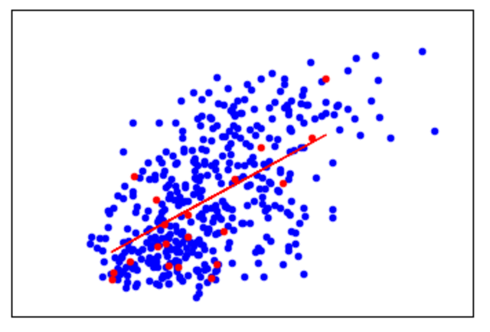
Reality can be a little more like this…
Notes:
1-feature linear regression on the Diabetes dataset. This is where you need to change your model. In this case, you’d start by trying more features, then adapting the model hyperparameters (e.g. it might not be a straight line that you need to fit) or the model that you use (e.g. linear regression might not be the best model type to use on this dataset).

Slide 16
Classification: Predict classes
Well pump: [working, broken]
CV: [accept, reject]
Gender: [male, female, others]
Iris variety: [iris setosa, iris virginica, iris versicolor]
Notes:
When there are just two classifications, it’s called binary classification.

Slide 17

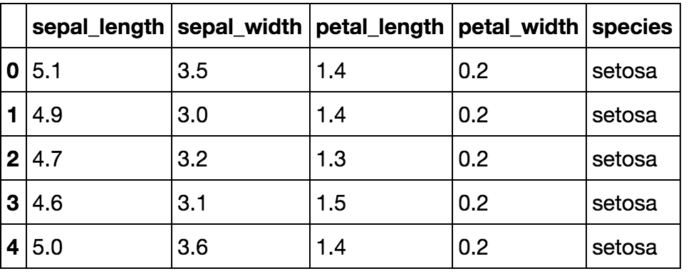
Classification: The Iris Dataset
Petal
Sepal
Notes:
Classification: finding the link between data and classes.
This is the Iris dataset. It’s one of Scikit-learn’s example datasets.

Slide 18
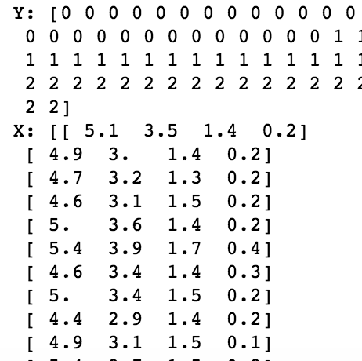
Classification: first get your data
import numpy as np
from sklearn import datasets
iris = datasets.load_iris()
X = iris.data
Y = iris.target
Notes:
print("Targets: {}".format(iris['target_names']))
print("Target data: {}".format(iris_Y))
print("Features: {}".format(iris['feature_names']))
print("Feature data: {}".format(iris_X))

Slide 19
Classification: Split your data
ntest=10
np.random.seed(0)
indices = np.random.permutation(len(X))
iris_X_train = X[indices[:-ntest]]
iris_Y_train = Y[indices[:-ntest]]
iris_X_test = X[indices[-ntest:]]
iris_Y_test = Y[indices[-ntest:]]
Notes:
Why do we split into training and test sets? This is called a “holdout” set… we save some of our data, so we can use it to check how well our classifier does on data it hasn’t seen before.
print(‘{} training points, {} test points’.format(len(iris_X_train), len(iris_X_test)))

Slide 20
Classifier: Fit Model to Data
from sklearn.neighbors import KNeighborsClassifier
knn = KNeighborsClassifier(n_neighbors=5, metric='minkowski')
knn.fit(iris_X_train, iris_Y_train)
Notes:
This is the k nearest neighbours algorithm. For every new datapoint, it looks at the N nearest datapoints it has classifications for, and assigns the new datapoint the class that’s most common amongst them.
Here, we’re using 5 neighbours. We’re also using the Minkowski distance (https://machinelearning1.wordpress.com/2013/03/25/three-famous-metrics-manhattan-euclidean-minkowski/) : this tells the algorithm how to compute the distance between two points, so we can define which points are ‘closest’. Common distance metrics you’ll see in machine learning include:
Manhattan, or “city block” distance: add the distance along the x axis to the distance along the y axis (“city block” because that’s how you navigate in Manhattan”)
Euclidian distance: calculate the straight-line distance between the two points (e.g. sqrt(x^2 + y^2))
Minkowski distance: a variant of Euclidian distance, for large numbers of features

Slide 21
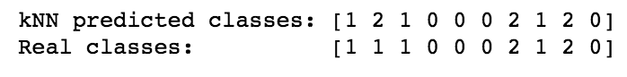
Classifier: Check your model
predicted_classes = knn.predict(iris_X_test)
print('kNN predicted classes: {}'.format(predicted_classes))
print('Real classes: {}'.format(iris_Y_test))

Slide 22
Clustering: Find groups in your data

Slide 23
Clustering: get your data
from sklearn import datasets
iris = datasets.load_iris()
X = iris.data
Y = iris.target
print("Xs: {}".format(X))

Slide 24
Clustering: Fit model to data
from sklearn import cluster
k_means = cluster.KMeans(3)
k_means.fit(iris.data)

Slide 25
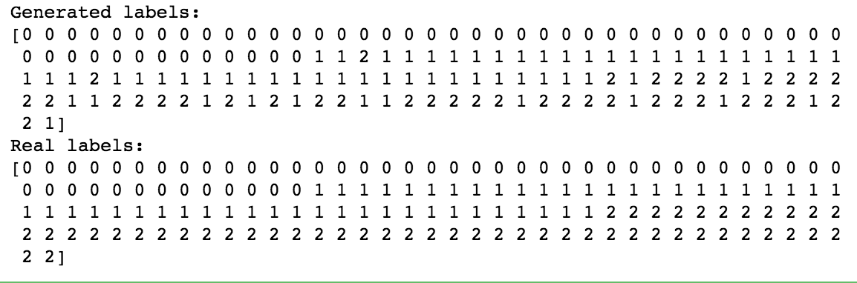
Clustering: Check your model
print("Generated labels: \n{}".format(k_means.labels_))
print("Real labels: \n{}".format(Y))

Slide 26
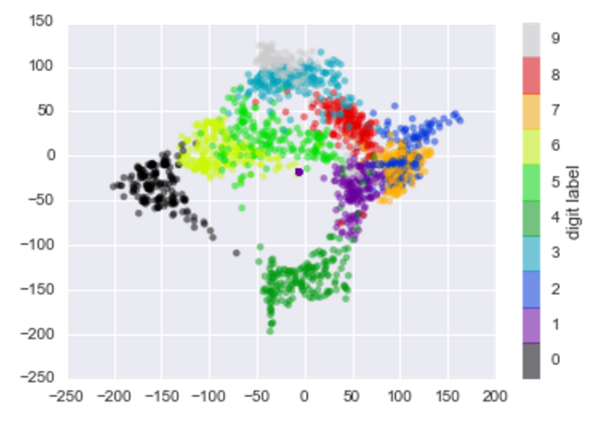
Dimensionality Reduction
Notes:
This is the digits example dataset.

Slide 27
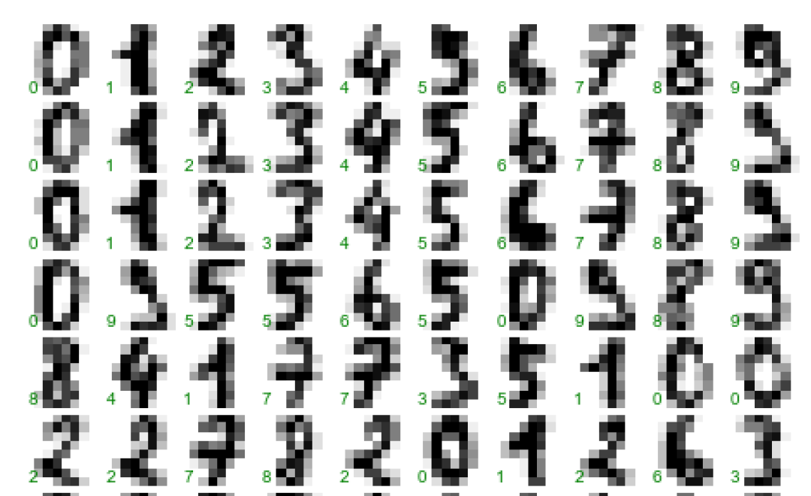
Dimensionality reduction: Get your data
Notes:
This is all in notebook 6.5

Slide 28
Dimensionality reduction: Fit model to data

Slide 29
Recap: Choosing an Algorithm
Have: data and expected outputs
Want numbers? Try regression algorithms
Want classes? Try classification algorithms
Have: just data
Want to find structure? Try clustering algorithms
Want to look at it? Try dimensionality reduction
Notes:
There’s no “best” algorithm for every problem. This is also known as the “no free lunch” theory.
If you have data and estimate of better/worse: reinforcement learning
There are lots of variants on these algorithms: the Scikit-learn cheat sheet will help you choose between them: http://scikit-learn.org/stable/tutorial/machine_learning_map/

Slide 30
Model Validation

Slide 31
How well does the model fit new data?
“Holdout sets”:
split your data into training and test sets
learn your model with the training set
get a validation score for your test set
Models are rarely perfect… you might have to change parameters or model
underfitting: model not complex enough to fit the training data
overfitting: model too complex: fits the training data well, does badly on test
Notes:
Overfitting: matches the training data well, performs badly on new data… has high variance
Underfitting: doesn’t match the training data well, might perform well on new data… has high bias
Bias/ Variance tradeoff: adjust your hyperparameters until the model performs well on the test data.
See e.g. http://scott.fortmann-roe.com/docs/BiasVariance.html

Slide 32
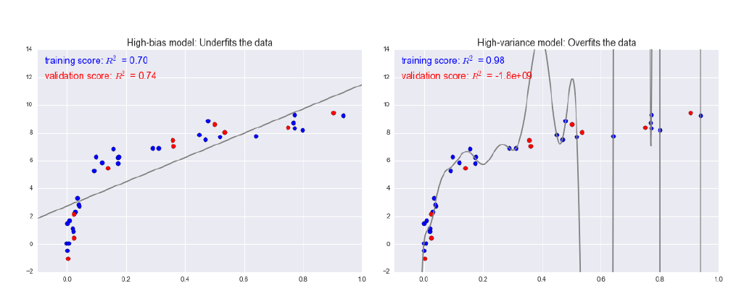
Overfitting and underfitting
Notes:
This is all about your parameters e.g. the difference between fitting a straight line, a quadratic curve or a n-dimensional curve.
Figures from Jake Van Der Plas’ Python for Data Science book.
We’ll talk about the bias-variance tradeoff later.

Slide 33
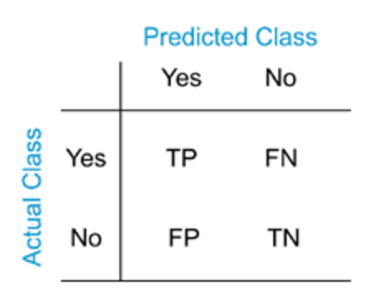
The Confusion Matrix
True positive
False positive
False negative
True negative
Notes:
False positive is also known as a “type 1 error”; false negative is also known as a “type 2 error”.

Slide 34
Test Metrics
Precision:
of all the “true” results, how many were actually “true”?
Precision = tp / (tp + fp)
Recall:
how many of the things that were really “true” were marked as “true” by the classifier?
Recall = tp / (tp + fn)
F1 score:
harmonic mean of precision and recall
F1_score = 2 * precision * recall / (precision + recall)
Notes:
These numbers are always between 0 and 1. If you want to play with F1, try it in Python, e.g.:
import numpy as np
p = np.array([.25, .25, .125, .5, .75])
r = np.array([.001, .10, .7, .9, .3])
2*p*r / (p + r)

Slide 35
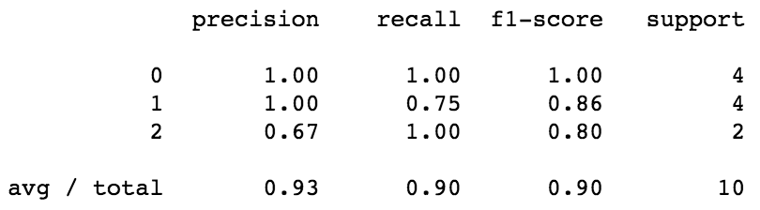
Iris classification: metrics
from sklearn import metrics
print(metrics.classification_report(iris_Y_test, predicted_classes))
Notes:
Support: how many things that are actually this class did we use to calculate these metrics?
Precision: of all the “true” results, how many were actually “true”?
Recall: how many of the things that were really “true” were marked as “true” by the classifier?
F1: combination of precision and recall

Slide 36
Exercises

Slide 37
Explore some algorithms
Notebooks 6.x contain examples of machine learning algorithms. Run them, play with the numbers in them, break them, think about why they might have broken.

